Slide 1


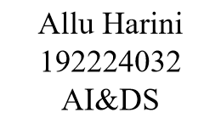
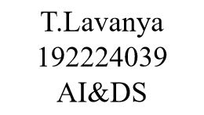
THE ROLE OF A PROCESS MANAGER ENHANCING EFFICIENCY AND PRODUCTIVITY
CSA0430 - Operating System for Task Synchronization
Faculty - Dr G Mary Valantina

Slide 2
What are we going to see?
Introduction
Process creation and termination
Process states
Process scheduling
Scheduling algorithms
Context switching
Synchronization and dead lock handling

Slide 3
Introduction
The process manager is a crucial component of an operating system.
It handles the execution of processes and manages resources efficiently.
Ensures smooth and fair process execution to maintain system stability and performance.

Slide 4
Process creation and termination:
Process Creation:
Processes are created using system calls (e.g., fork in UNIX/Linux).
A new process is called a child process, created by a parent process.
Process Termination:
Processes can terminate voluntarily (exit) or involuntarily (killed by the OS).
On termination, resources are freed, and the process state is updated

Slide 5
A process goes through a discrete process state Various events can cause a process to change states:
Submit state
01
Hold state
02
Ready state
03
Running
04
Wait
05
Complete
06

Slide 6
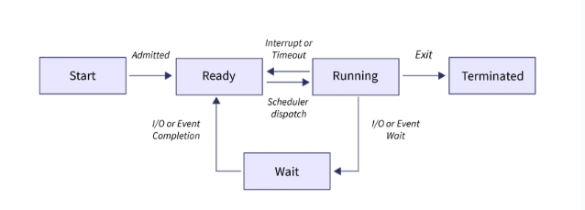
Process State

Slide 7

Process Scheduling
Process scheduling is one of the most important functions of an operating system that supports multiprogramming.
Determines the order of process execution.
Ensures fair and efficient CPU usage.

Slide 8
Scheduling Algorithms
First in first served(FCFS)
Shortest job first(SJF)
Priority
Round Robin

Slide 9
First come first served Algorithm
Overview
Jobs are scheduled in order of arrival
Non preemptive
Problem
Average waiting time depends on arrival order
Troublesome for time sharing systems
Advantages
Really simple!

Slide 10
Shortest job First Algorithm
Process Selection:
Advantages:
Minimizes average waiting time.
Reduce overall turn around time.
Disadvantages :
Chooses the process with the shortest Brust time.
Two types- preemptive and non-preemptive.
Requires precise knowledge of Excetuion times.
Can cause starvation for longer process.

Slide 11
Priority Algorithm
Definition
Processes are assigned priority levels.
Higher priority processes execute before lower ones.
Types
Preemptive: Can interrupt lower priority processes.
Non-Preemptive: Runs to completion once started.
Key Considerations
Starvation: Lower priority processes may be indefinitely delayed.
Aging: Gradually increases priority of waiting processes to prevent starvation.

Slide 12
Round Robin Algorithm
Definition
Processes are assigned equal time slices (quantum).
Executes processes in a cyclic order.
Mechanism
Each process gets an equal time slice.
If a process isn’t completed, it’s placed at the end of the queue.
Key Considerations
Needs to be carefully chosen to balance responsiveness and overhead.
Ensures all processes receive equal CPU time without starvation.

Slide 13

Process control bank (PCB) Management
PCB Definition:
A data structure containing process information.
Information Stored:
Process state
Program counter
CPU registers
Memory limits
I/O status information

Slide 14

Context Switching
Definition:
The process of saving the state of a running process and loading the state of another process.
Importance:
Allows multiple processes to share a single CPU.
Steps Involved:
Save current process state.
Load next process state.

Slide 15

Synchronization and Deadlock Handling
Synchronization:
Ensures processes do not interfere with each other.
Techniques: Mutexes, Semaphores.
Deadlock Handling:
Deadlock: Processes waiting indefinitely for resources.
Prevention: Avoiding deadlock conditions.
Detection and Recovery: Identifying and resolving deadlocks.

Slide 16
conclusion
The process manager is crucial for an OS.
Manages process creation, scheduling, and termination.
Ensures efficient and fair resource usage.
Facilitates communication and synchronization between processes.
Prevents and handles deadlocks, maintaining system stability.

Slide 17


